Slide 1
Clustering

Slide 2
Supervised learning vs. unsupervised learning
Supervised learning: discover patterns in the data that relate data attributes with a target (class) attribute.
These patterns are then utilized to predict the values of the target attribute in future data instances.
Unsupervised learning: The data have no target attribute.
We want to explore the data to find some intrinsic structures in them.

Slide 3
What is Unsupervised Learning?
Unsupervised learning is a machine learning paradigm where the algorithm learns patterns and structures from input data without explicit supervision.
Unlike supervised learning, there are no labeled target variables. The algorithm must find inherent patterns on its own.
The primary goal is to explore and uncover underlying relationships and groupings in the data.

Slide 4
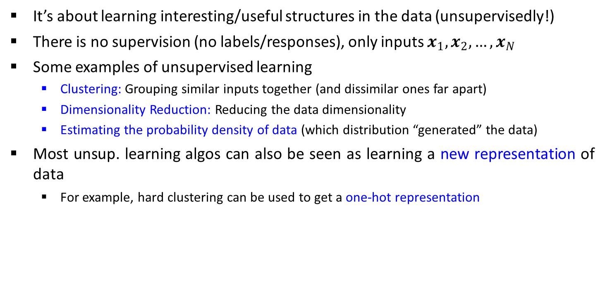
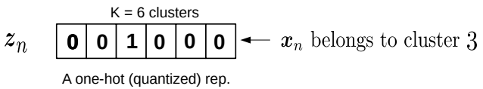
Cont.
Each point belongs deterministically to a single cluster

Slide 5
Clustering
Clustering is a technique for finding similarity groups in data, called clusters. I.e.,
it groups data instances that are similar to (near) each other in one cluster and data instances that are very different (far away) from each other into different clusters.
Clustering is often called an unsupervised learning task as no class values denoting an a priori grouping of the data instances are given, which is the case in supervised learning.
Due to historical reasons, clustering is often considered synonymous with unsupervised learning.
In fact, association rule mining is also unsupervised

Slide 6
Clustering techniques
Clustering has been studied extensively for more than 40 years and across many disciplines due to its broad applications.
we shall cover the following clustering techniques.
k-Means algorithm [1957, 1967]
k-Medoids algorithm
k-Modes [1998]
Fuzzy c-means algorithm [1999]
Partitioning methods
Divisive
Hierarchical methods
Agglomerative methods
Clustering Techniques
Density-based methods
STING [1997]
DBSCAN [1996]
CLIQUE [1998]

Slide 7
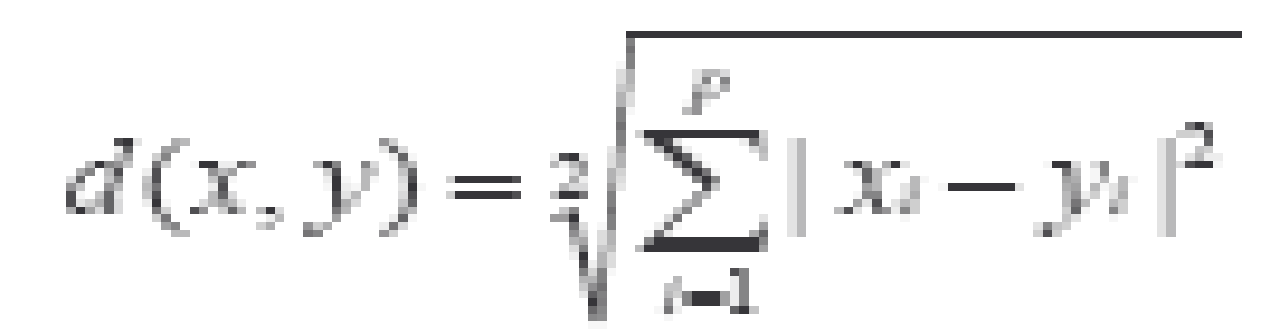

Common Distance measures:
Distance measure will determine how the similarity of two elements is calculated and it will influence the shape of the clusters.
They include:
1. The Euclidean distance (also called L2-norm distance) is given by:
2. The Manhattan distance (also called taxicab norm or L1-norm) is given by:

Slide 8

3. The maximum norm is given by:
The Mahalanobis distance corrects data for different scales and correlations in the variables.
Inner product space: The angle between two vectors can be used as a distance measure when clustering high dimensional data.
6. Hamming distance (sometimes edit distance) measures the minimum number of substitutions required to change one member into another.

Slide 9
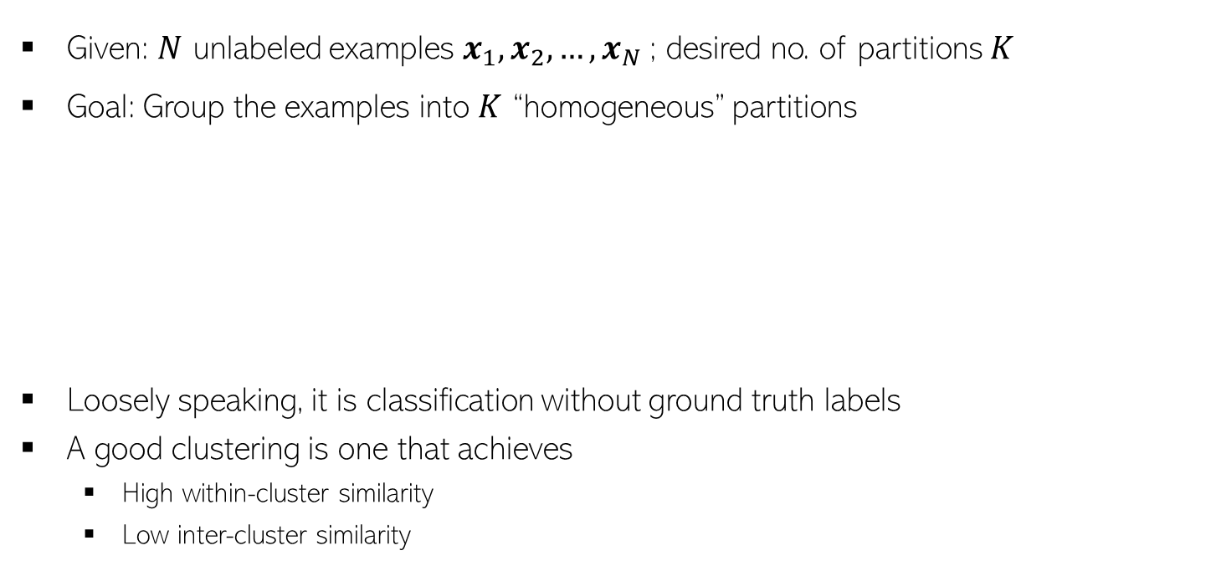
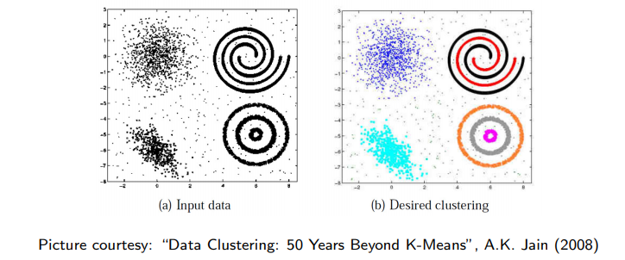
Let’s dive in…
In some cases, we may not know the right number of clusters in the data and may want to learn that (technique exists for doing this but beyond the scope)

Slide 10
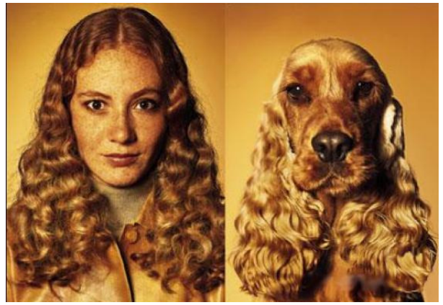
Similarity can be Subjective
Clustering only looks at similarities b/w inputs, since no labels are given
Without labels, similarity can be hard to define
Thus using the right distance/similarity is very important in clustering
In some sense, related to asking: “Clustering based on what”?
Picture courtesy: http://www.guy-sports.com/humor/videos/powerpoint presentation dogs.htm

Slide 11
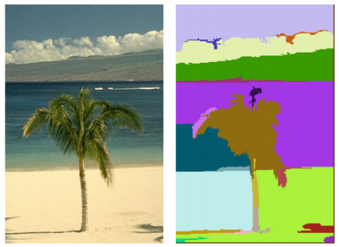
Clustering: Some Examples
Document/Image/Webpage Clustering
Image Segmentation (clustering pixels)
Clustering web-search results
Clustering (people) nodes in (social) networks/graphs
.. and many more..
Picture courtesy: http://people.cs.uchicago.edu/∼pff/segment/

Slide 12
Initializing K-means.
Initializing K-means is the initial step of the K-means clustering algorithm, which is an unsupervised machine learning technique used for partitioning data points into K clusters.
The goal of K-means is to minimize the sum of squared distances between data points and their corresponding cluster centers, often referred to as centroids.

Slide 13
General process for initializing K-means
Choose the number of clusters (K): Decide the number of clusters you want to partition your data into. This is a user-specified parameter and requires domain knowledge or experimentation to determine the optimal value.
Select initial centroids: Randomly select K data points from your dataset as the initial centroids. These data points will serve as the starting positions for the cluster centers.
Assign data points to clusters: Calculate the distance between each data point and all the centroids. Assign each data point to the cluster with the nearest centroid. This step forms the initial clustering.

Slide 14
Cont.
4. Update centroids: Calculate the mean (center) of the data points within each cluster and move the centroids to these new positions.
5. Repeat steps 3 and 4: Continue steps 3 and 4 iteratively until convergence or until a specified number of iterations is reached. Convergence happens when the cluster assignments stop changing significantly or when the centroids stop moving substantially.
6. Final clustering: Once convergence is reached, the algorithm stops, and you have your final clustering result.

Slide 15
K-Means Algorithm
K-Means clustering algorithm proposed by J. Hartigan and M. A. Wong [1979].
Given a set of n distinct objects, the k-Means clustering algorithm partitions the objects into k number of clusters such that intracluster similarity is high but the intercluster similarity is low.
In this algorithm, user has to specify k, the number of clusters and consider the objects are defined with numeric attributes and thus using any one of the distance metric to demarcate the clusters.

Slide 16
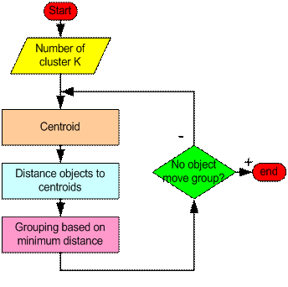
What have we learned so far…

Slide 17
Step 1: Begin with a decision on the value of k = number of clusters .
Step 2: Put any initial partition that classifies the data into k clusters. You may assign the training samples randomly, or systematically as the following:
Take the first k training sample as single-element clusters
Assign each of the remaining (N-k) training sample to the cluster with the nearest centroid. After each assignment, recompute the centroid of the gaining cluster.

Slide 18
Step 3: Take each sample in sequence and compute its distance from the centroid of each of the clusters. If a sample is not currently in the cluster with the closest centroid, switch this sample to that cluster and update the centroid of the cluster gaining the new sample and the cluster losing the sample.
Step 4: Repeat step 3 until convergence is achieved, that is until a pass through the training sample causes no new assignments.

Slide 19
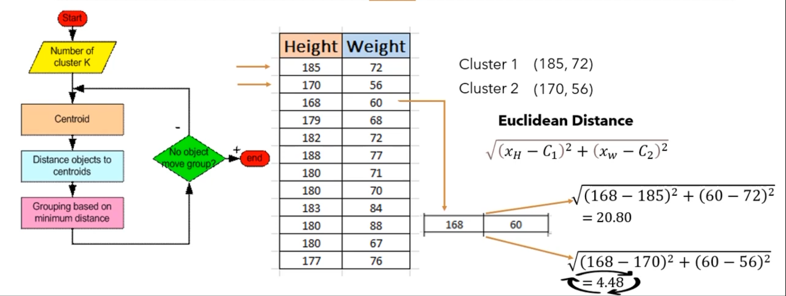

Slide 20
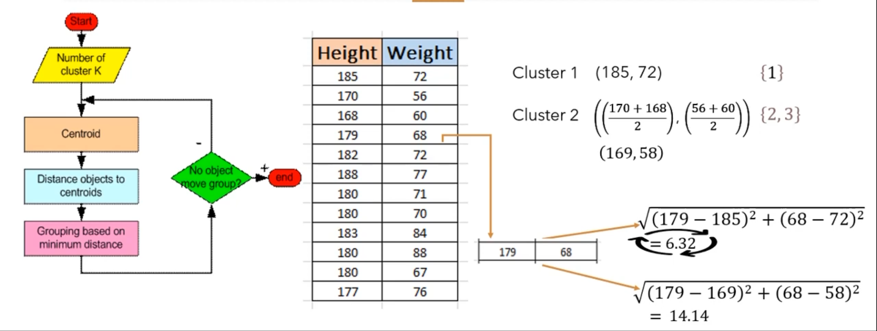

Slide 21
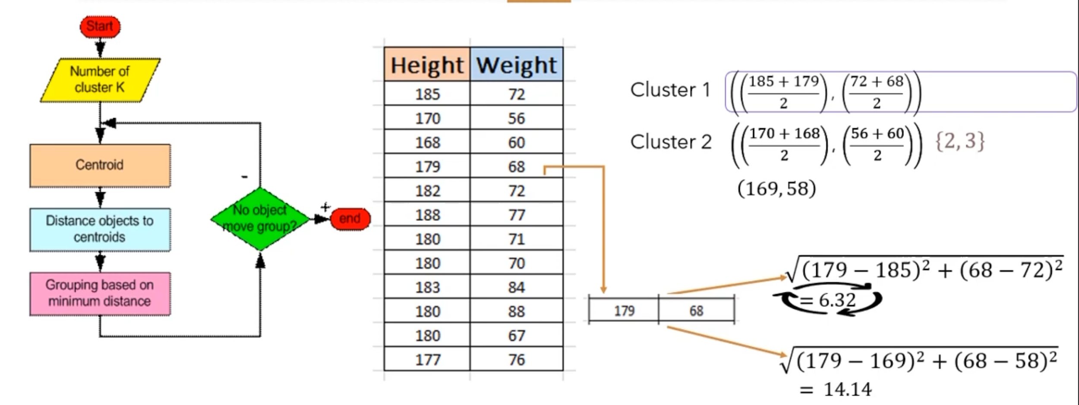

Slide 22
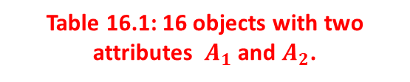
Example
Fig 16.1: Plotting data of Table 16.1
A₁ | A₂
6.8 | 12.6
0.8 | 9.8
1.2 | 11.6
2.8 | 9.6
3.8 | 9.9
4.4 | 6.5
4.8 | 1.1
6.0 | 19.9
6.2 | 18.5
7.6 | 17.4
7.8 | 12.2
6.6 | 7.7
8.2 | 4.5
8.4 | 6.9
9.0 | 3.4
9.6 | 11.1

Slide 23
Illustration of k-Means clustering algorithms
Suppose, k=3. Three objects are chosen at random shown as circled (see Fig 16.1). These three centroids are shown below.
Initial Centroids chosen randomly
Let us consider the Euclidean distance measure (L₂ Norm) as the distance measurement in our illustration.
Let d₁, d₂ and d₃ denote the distance from an object to c₁, c₂ and c₃ respectively. The distance calculations are shown in Table 16.2.
Assignment of each object to the respective centroid is shown in the right-most column and the clustering so obtained is shown in Fig 16.2.
Centroid |  | Objects
 | A1 |  | A2
c₁ | 3.8 |  | 9.9
c₂ | 7.8 |  | 12.2
c₃ | 6.2 |  | 18.5

Slide 24
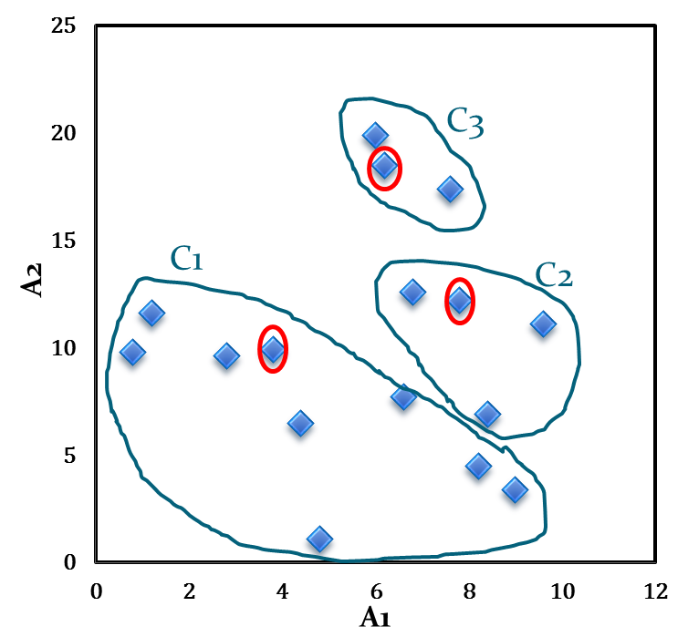
Illustration of k-Means clustering algorithms
Table 16.2: Distance calculation
Fig 16.2: Initial cluster with respect to Table 16.2
A₁ | A₂ | d₁ | d₂ | d₃ | _{cluster}
6.8 | 12.6 | 4.0 | 1.1 | 5.9 | 2
0.8 | 9.8 | 3.0 | 7.4 | 10.2 | 1
1.2 | 11.6 | 3.1 | 6.6 | 8.5 | 1
2.8 | 9.6 | 1.0 | 5.6 | 9.5 | 1
3.8 | 9.9 | 0.0 | 4.6 | 8.9 | 1
4.4 | 6.5 | 3.5 | 6.6 | 12.1 | 1
4.8 | 1.1 | 8.9 | 11.5 | 17.5 | 1
6.0 | 19.9 | 10.2 | 7.9 | 1.4 | 3
6.2 | 18.5 | 8.9 | 6.5 | 0.0 | 3
7.6 | 17.4 | 8.4 | 5.2 | 1.8 | 3
7.8 | 12.2 | 4.6 | 0.0 | 6.5 | 2
6.6 | 7.7 | 3.6 | 4.7 | 10.8 | 1
8.2 | 4.5 | 7.0 | 7.7 | 14.1 | 1
8.4 | 6.9 | 5.5 | 5.3 | 11.8 | 2
9.0 | 3.4 | 8.3 | 8.9 | 15.4 | 1
9.6 | 11.1 | 5.9 | 2.1 | 8.1 | 2

Slide 25
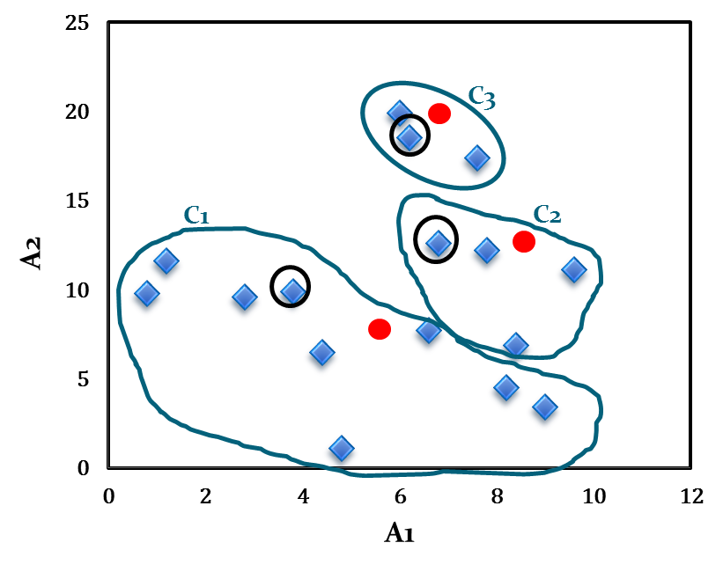
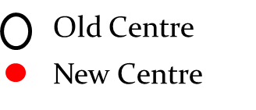
Illustration of k-Means clustering algorithms
The calculation new centroids of the three cluster using the mean of attribute values of A₁ and A₂ is shown in the Table below. The cluster with new centroids are shown in Fig 16.3.
Calculation of new centroids
New Centroid |  | Objects
 | A1 |  | A2
c₁ | 4.6 |  | 7.1
c₂ | 8.2 |  | 10.7
c₃ | 6.6 |  | 18.6
Fig 16.3: Initial cluster with new centroids

Slide 26
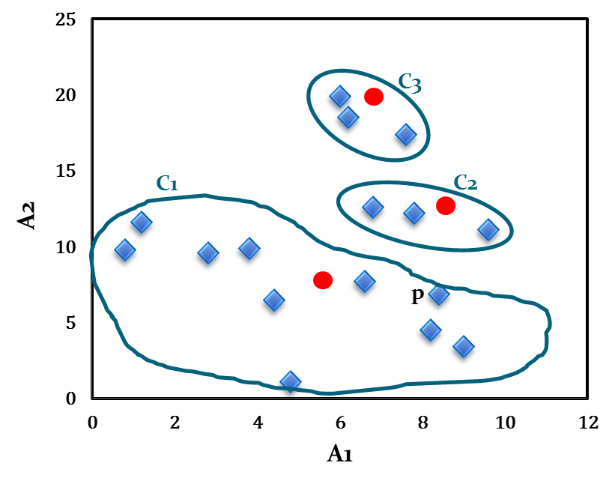
Illustration of k-Means clustering algorithms
We next reassign the 16 objects to three clusters by determining which centroid is closest to each one. This gives the revised set of clusters shown in Fig 16.4.
Note that point p moves from cluster C₂ to cluster C₁.
Fig 16.4: Cluster after first iteration

Slide 27
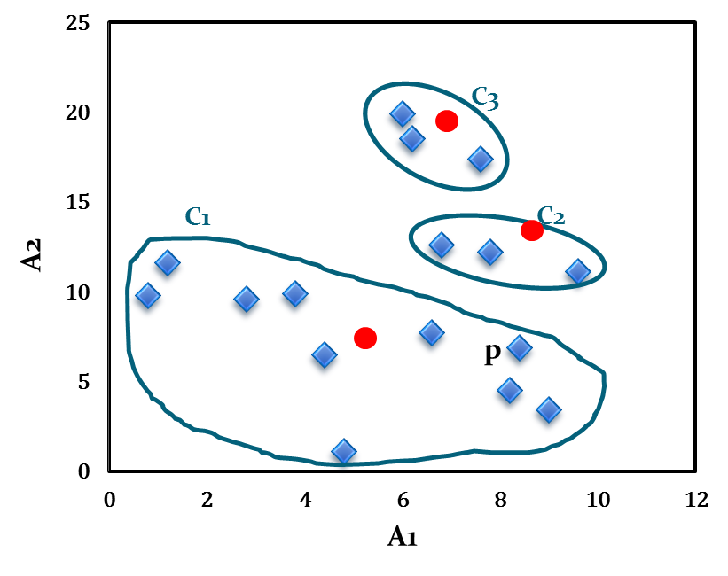
Illustration of k-Means clustering algorithms
The newly obtained centroids after second iteration are given in the table below. Note that the centroid c₃ remains unchanged, where c₂ and c₁ changed a little.
With respect to newly obtained cluster centres, 16 points are reassigned again. These are the same clusters as before. Hence, their centroids also remain unchanged.
Considering this as the termination criteria, the k-means algorithm stops here. Hence, the final cluster in Fig 16.5 is same as Fig 16.4.
Fig 16.5: Cluster after Second iteration
Cluster centres after second iteration
Centroid | Revised Centroids
 | A1 | A2
c₁ | 5.0 | 7.1
c₂ | 8.1 | 12.0
c₃ | 6.6 | 18.6

Slide 28
Solve the Problem using K-Means Clustering
Cluster the following eight points (with (x, y) representing locations) into three clusters:
A1(2, 10), A2(2, 5), A3(8, 4), A4(5, 8), A5(7, 5), A6(6, 4), A7(1, 2), A8(4, 9)
Initial cluster centers are: A1(2, 10), A4(5, 8) and A7(1, 2).

Slide 29
Algorithm Implementation
from sklearn.datasets import make_blobs
X,y= make_blobs(n_samples=150, n_features=2, centers=3, cluster_std=0.5, shuffle=True,random_state=0)
import matplotlib.pyplot as plt
plt.scatter(X[:,0], X[:,1],c='blue', marker='o', s=30)
plt.grid()
plt.show()

Slide 30
from sklearn.cluster import KMeans
km= KMeans(n_clusters=3,init='random',n_init=10,max_iter=300, random_state=0)
y_km= km.fit_predict(X)
plt.scatter(X[y_km == 0,0],X[y_km==0,1], s=30, c='green',marker='s', label="cluster1")
plt.scatter(X[y_km == 1,0],X[y_km==1,1], s=30, c='blue',marker='o', label="cluster2")
plt.scatter(X[y_km == 2,0],X[y_km==2,1], s=30, c='red',marker='v', label="cluster3")
plt.scatter(km.cluster_centers_[:,0],km.cluster_centers_[:,1],
s=200, marker="*", c="black", label="centroids")
plt.grid()
plt.show()

Slide 31
Write a program to implement k-means clustering without using sklearn library

Slide 32
Write a program to implement Kmeans clustering on any dataset from UCI ML repository/Kaggle.

Slide 33
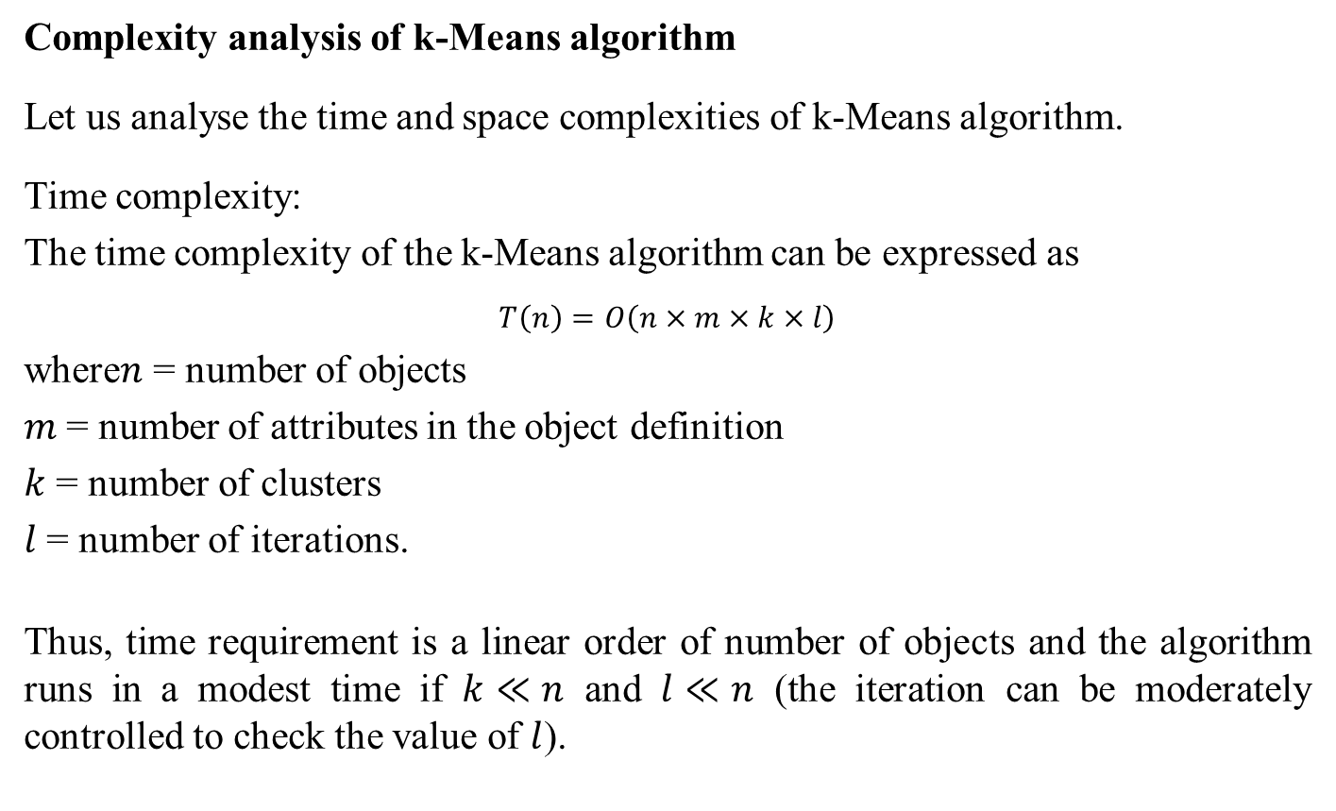
K-Means Algorithm Complexity

Slide 34
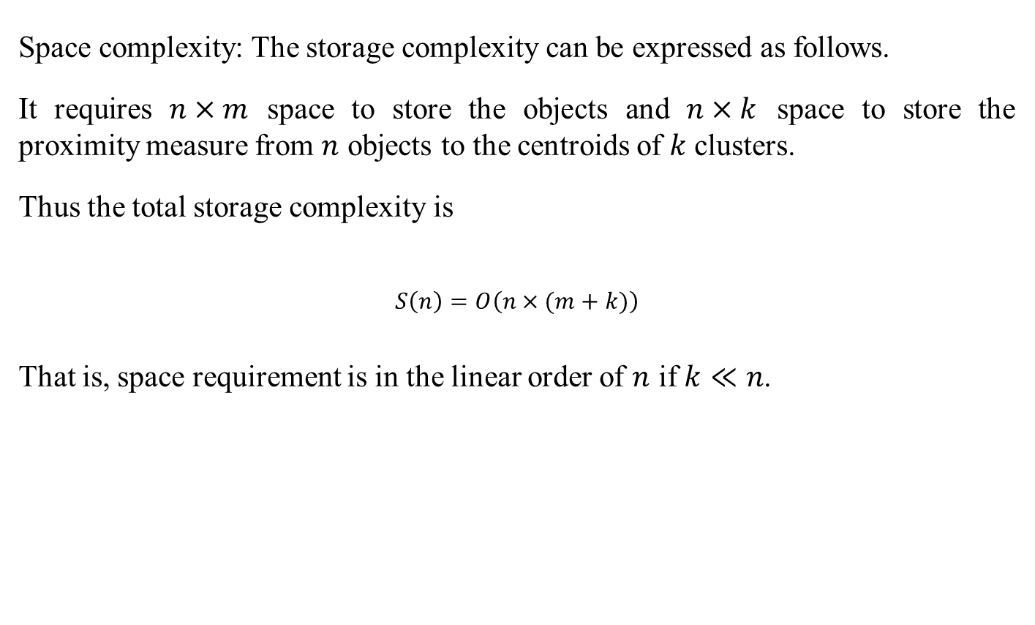
Comments on k-Means algorithm

Slide 35
Advantages
K-Means is simple and can be used for a wide variety of object types.
It is also efficient both from storage requirement and execution time point of views. By saving distance information from one iteration to the next, the actual number of distance calculations, that must be made can be reduced (specially, as it reaches towards the termination).
How similarity metric can be utilized to run k-Means faster? What is the updation in each iteration?

Slide 36
Limitations
The K-Means is not suitable for all types of data. For example, k-Means does not work on categorical data because mean cannot be defined.
K-means finds a local optima and may actually minimize the global optimum.
K-means has trouble clustering data that contains outliers. When the SSE is used as objective function, outliers can unduly influence the cluster that are produced. More precisely, in the presence of outliers, the cluster centroids, in fact, not truly as representative as they would be otherwise. It also influence the SSE measure as well.
K-Means algorithm cannot handle non-globular clusters, clusters of different sizes and densities
K-Means algorithm not really beyond the scalability issue (and not so practical for large databases).

Slide 37
Thanks

